Slide 1

Final Assessment Software Testing QA
Prepared By: Zaid Alabed
Instructor: Dr.Ashraf Smadi

Slide 2
Agenda
Manual Testing
API Automation
Performance testing using k6
UI Automation ( Selenium )

Slide 3
Manual Testing
Total Executed 20
12 Passed
8 Failed

Slide 4


Automation Testing
UI Automation
API Automation
Scope: Automated critical user stories Like Login, Add to Cart and Checkout
Scope: Tested all CRUD operations (Get, Post, Put and Delete)
Goal: Verify functionality across different browsers
Goal: Ensure data integrity and correct status codes (200, 400 and 500)
Total Scenarios: 20 Happy Paths (standard_user): 12 Negative Paths(problem_user): 8
Result: 10+ Assertions running in CI/CD (Newman) and 100% Pass rate (Postman)

Slide 5
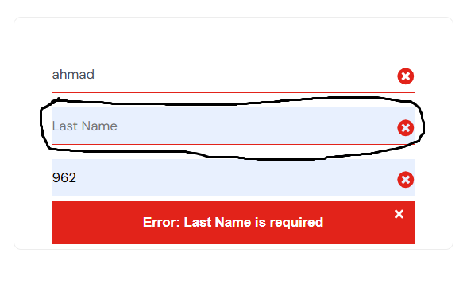
Critical Defect Discovery
Defect ID: Bug-001 (Checkout Blocked)
High Severity bug User cannot process the payment

Slide 6
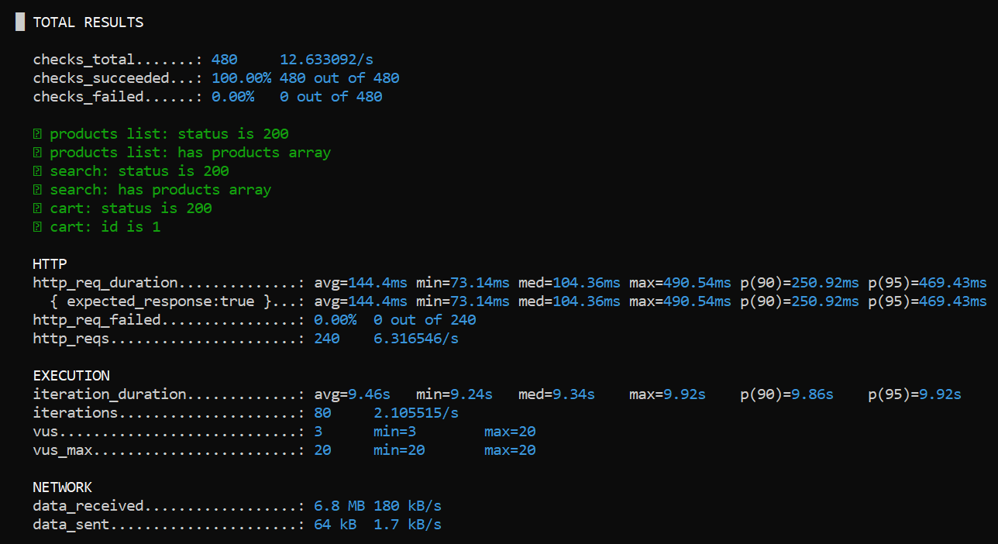
API Load Testing Result
Test Scenario
Tool Used: k6
Objective: Assess system stability under high traffic
Configuration: Simulated 20 Virtual Users (VUs) accessing the API concurrently for 30 seconds.
Key Findings
Total requests: 240
Stability: Achieved a 0% Error Rate
Conclusion: The API is stable and handled the load successfully

Slide 7
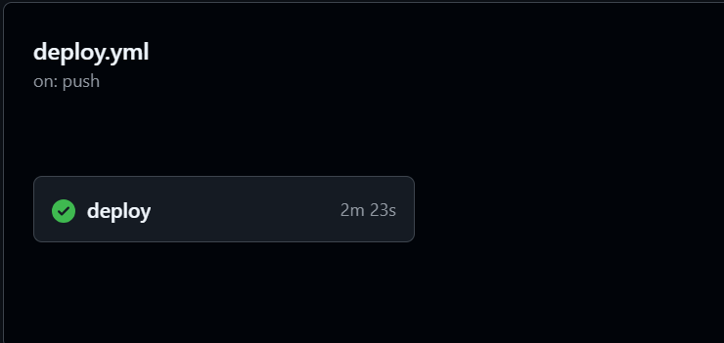
Continuous Integration (CI/CD)
Automated Safety Network
This pipeline represents our automated safety network. By integrating GitHub Actions every code commit now triggers a comprehensive suite of API and UI tests automatically and this will ensure that new features are deployed rapidly without introducing regressions.

Slide 8

Final Verdict & Recommendation
Frontend UI
Backend API
STATUS: NOT READY
STATUS: Ready
Stability: Critical
Stability: High
Biggest Blocker: Checkout Bug
Automation: Active
Decision (problem_user): Hold
Decision: Go Live

Slide 9
Thank You Any Questions?

